Slide 1
User Interface development for a web solution
Highlights of UI coding:
HTML
Java Script
Cascading Style sheets
Model View Controller (MVC)

Slide 2
User Interface (UI) development
A page from Easyjet.com to present UI development
Home page of Easyjet.com that enables users to enter flight details and click “Show Flights”.
Scope of this document:
To present UI coding with an emphasis on:
Hyper-text Markup Language (HTML),
Java Script &
Cascading Style Sheets (CSS)
Model View Controller (MVC)
The above are highlighted and marked using the arrow symbol in this presentation.

Slide 3
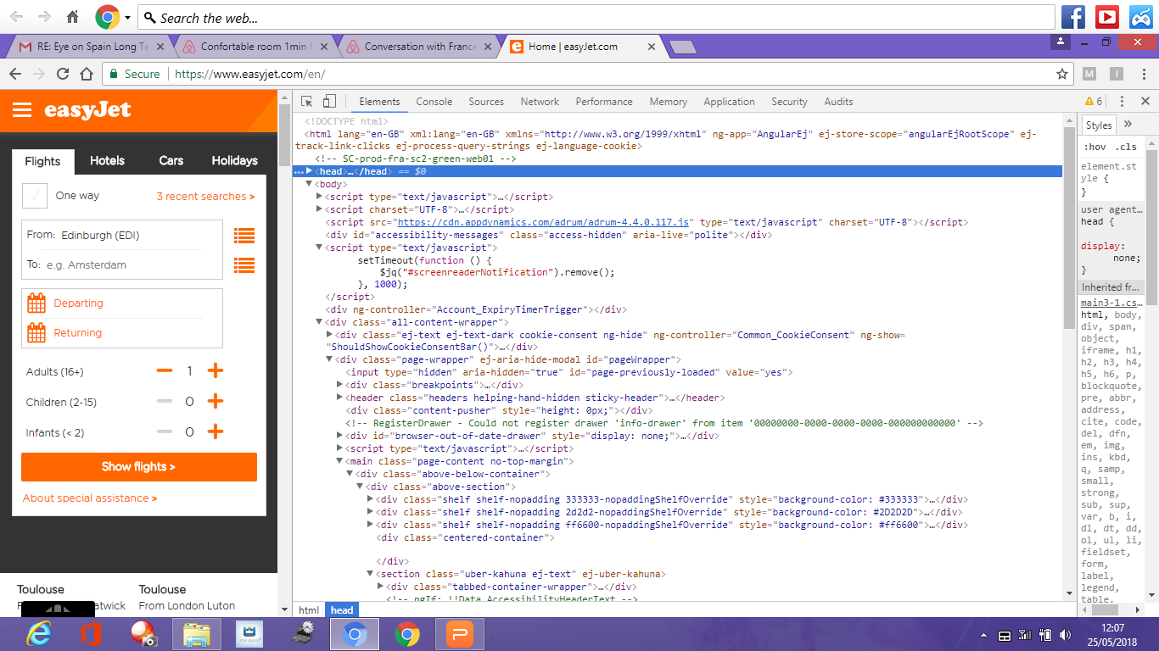
HTML Header and Body

Slide 4
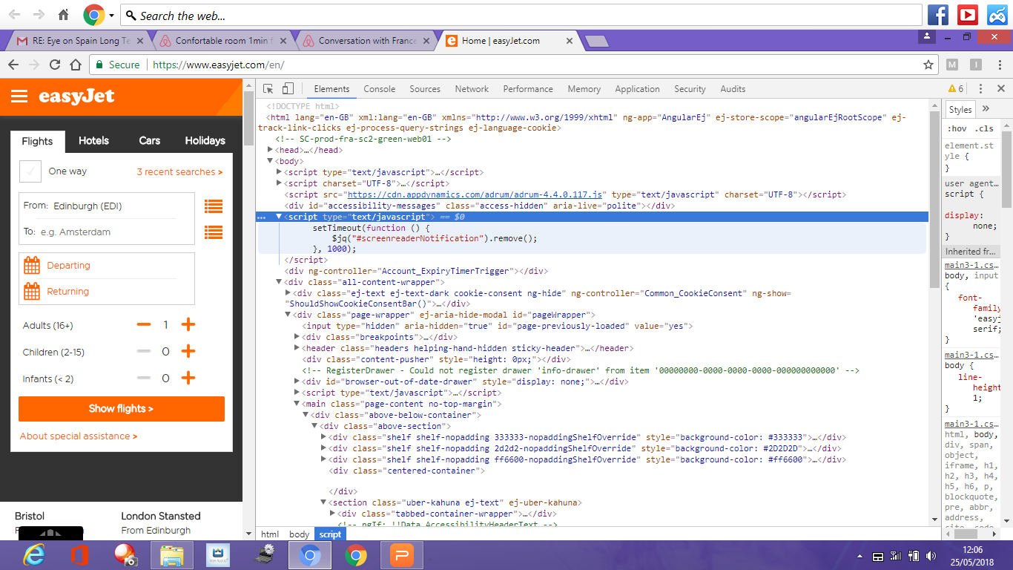
Java Script logic to set screen timeouts

Slide 5
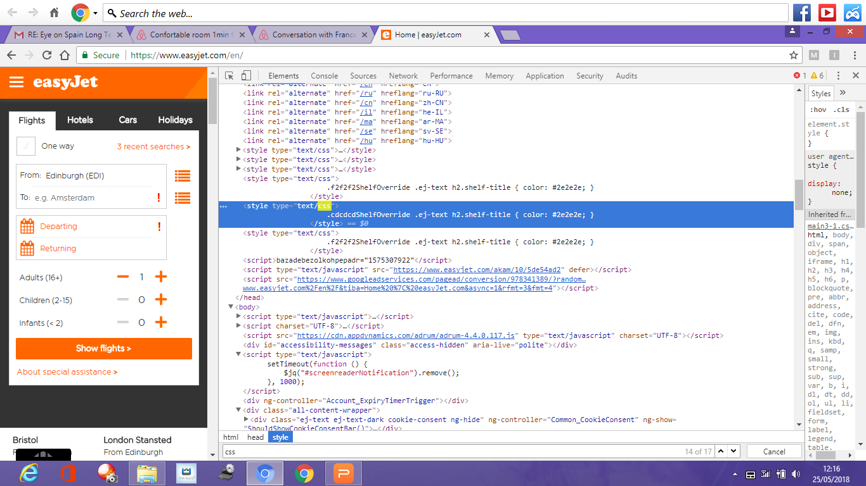
Cascading style sheets (CSS) determining look and feel of the page

Slide 6
Model View Controller (MVC) Pattern
View: HTML / JSP / ASP, that renders the web page
Model: Plain Old Java Objects (POJO) which usually defines & initializes the getters and setter methods for all the fields displayed on any page.
Pulic class JourneyDetails {
boolean onewayOrReturn;
String startingFrom;
String destination;
Date startDate;
Date returnDate;
Public String getDestination() {
return destination;
}
Public void setDestination(String destination) {
this.destination = destination;
}
// Shall include getters and setters for all the other fields too of any web page
}
Controller: Code that receives all the inputs from any web page, processes the logic by forwarding it to the backend and returns the outputs received back to the view for it to be rendered on the web page
Collection searchResults searchAvailableFlights(String startingFrom, String destination, Date start, Date return)
{
//Include the logic to invoke relevant backend services to search and return the list of all the available flights
}

